Slide 1
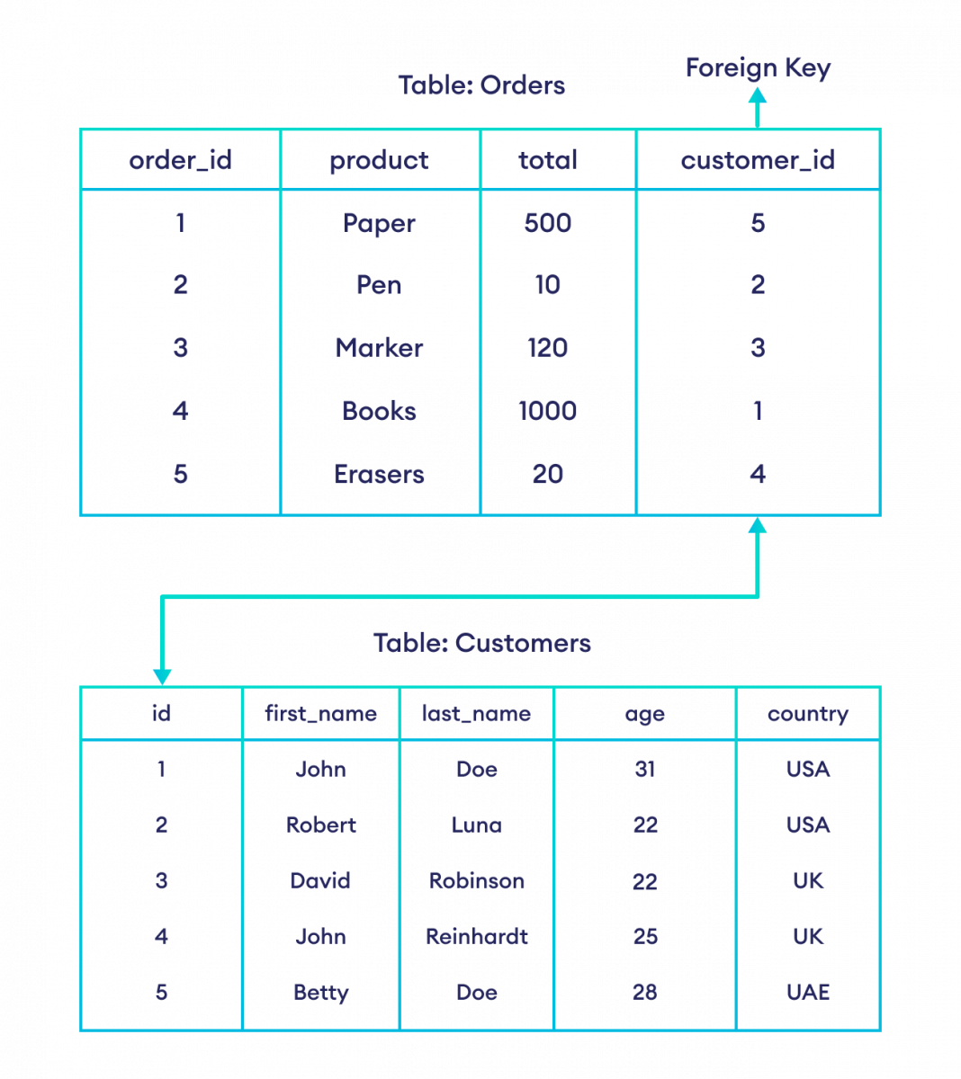
Foreign Key Constraint
FOREIGN KEY constraints are essential in database management. They establish relationships between tables, ensuring referential integrity.
How Foreign key works?
FOREIGN KEY constraint establishes a relationship between a column in one table (the child table) and a column in another table (the parent table).
For Example:

